Slide 1
Defining the scientific profile of the NVTG:
- Knowledge Agenda;
- Strategy;
- Network including collaboration with KCGH and OIGT
Presentation during the annual NVTG symposium on ‘Decolonsing Global Health’
24 November 2022

Slide 2
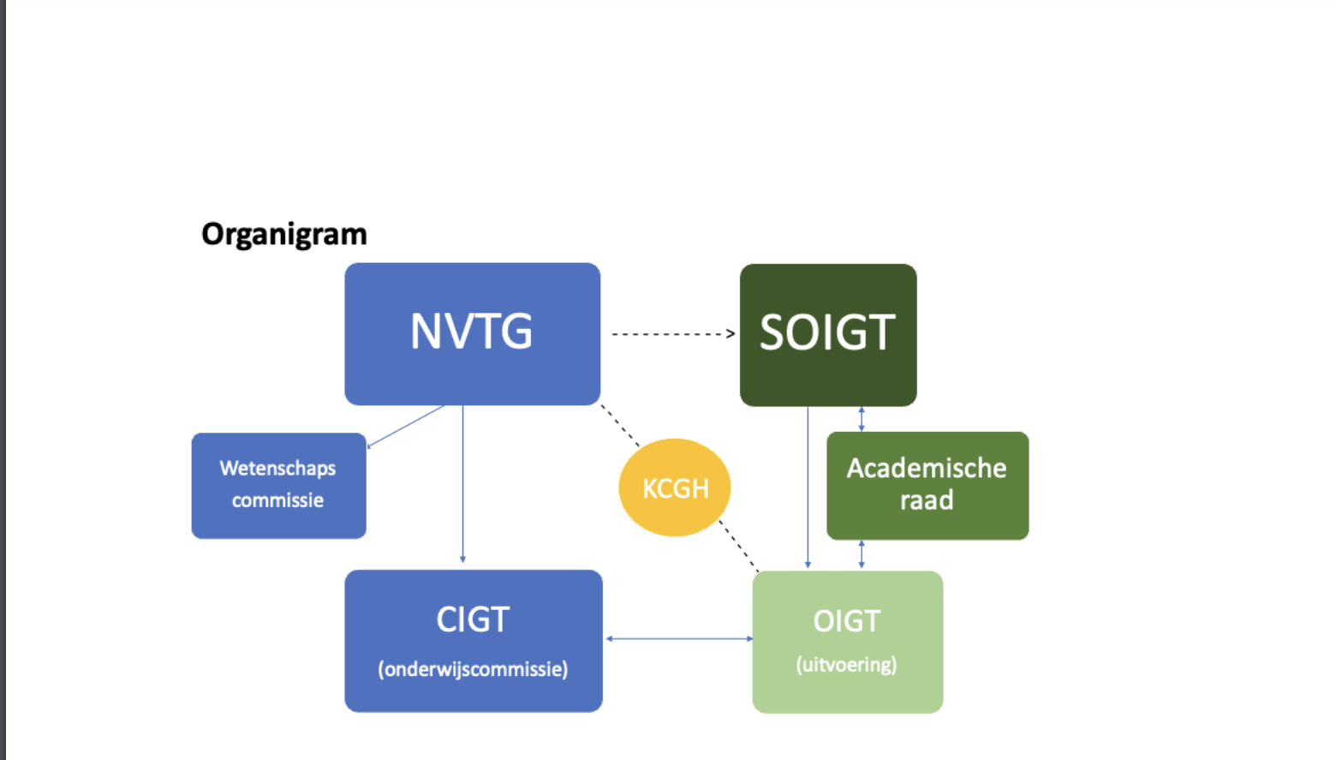
Previous Organisation chart of the pillar science (NVTG) and training programme (OIGT)

Slide 3



The Collaboration between OIGT / KCGH / NVTG is our basic framework

Slide 4

Proposed new framework for the science network
Science council
Academic centra
CIGT
Concilium education

Slide 5
Science council NVTG – Science Policy
Domains | Science in the Training Programme MD GH | Research and development of scientific base | Scientific network | Knowledge sharing and dissemination | Science in practice
Partners | CIGT OIGT | Academic centra in NL and their global partners NVTG Working Groups and their global partners | Academic centra in NL and their global partners NVTG Working Groups and their global partners Uniting Streams FESTMIH NWO NGOs Sharenet | NVTG Working Groups Werkgroepen Uniting Streams | Commission Continuous Education and Accreditation
Goals | Delivering content to CIGT Support to AIOS with an interest in science | Development and dissemination of a Knowledge Agenda Stimulate and facilitate the conduct of research | Collaboration and networking for high quality research in the domain of global health | To support members to participate in scientific meetings/congress and to write scientific publications To inform the group of health professionals about the latest scientific updates and get them involved in the public debate | Guarantee quality (continuos) education for MD GH Stimulate knowledge sharing and the implementation of knowledge in practice
Tasks / activities | Ongoing research for and development of the electives abroad PhD trayectories | Eijkman Medal Sauwerwein Medal Otto Kranendonk Foundation (grants) KCGH Thesis Award | Establish and sustain partnerships throughout the NVTG – OIGT – KCGH network (internal and external) | Organisation of scientific meetings, congresses: NVTG annual symposium, Global Health Day, ECTMIH Scientific publications and grey literature: TMIH and MTb | Organise continuous education Advise / develop protocols

Slide 6
Science in the training programme MD GH
The ‘Concilium International Health and Tropical medicine (CIGT) is het permanent advisory committee of the NVTG for the training of Medical Doctors Global Health.
    Responsibilites include advising the OIGT on the embedding of science in the curriculum
The newly to be established Science Council will become the advisory committee for MD GH in training with an interest in science.

